Slide 1
Technological and environmental aspects of working in Arctic conditions
Contingency plans
Cathrine S. Spikkerud & Geir Morten Skeie

Slide 2
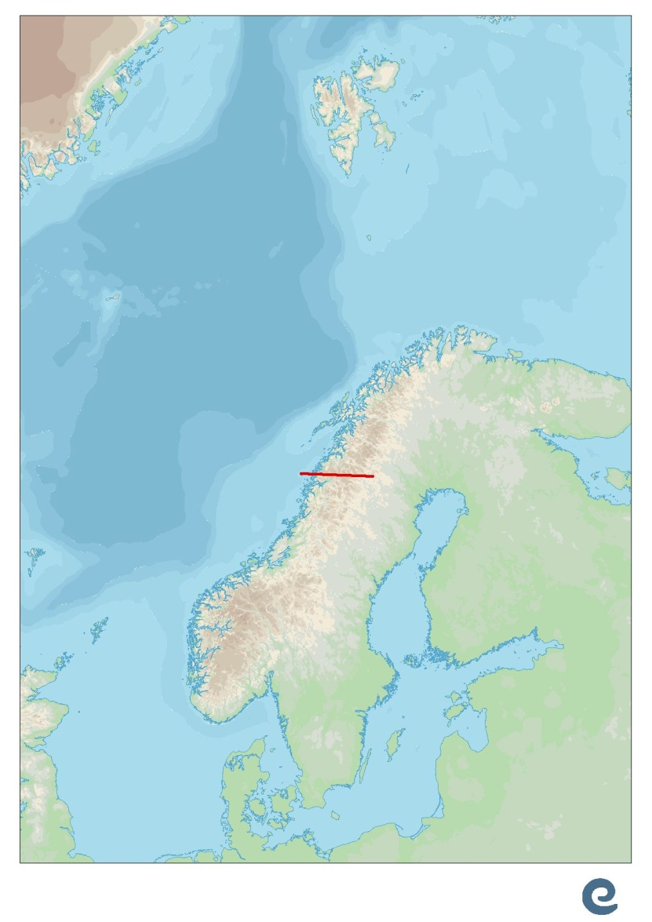
Environmental conditions
A long section of Norways coastline is north of the Polar Circle.
A very varied coastline, with varied environmental conditions
Rich in environmental resources
High regulatory focus
Consensus on priorities

Slide 3
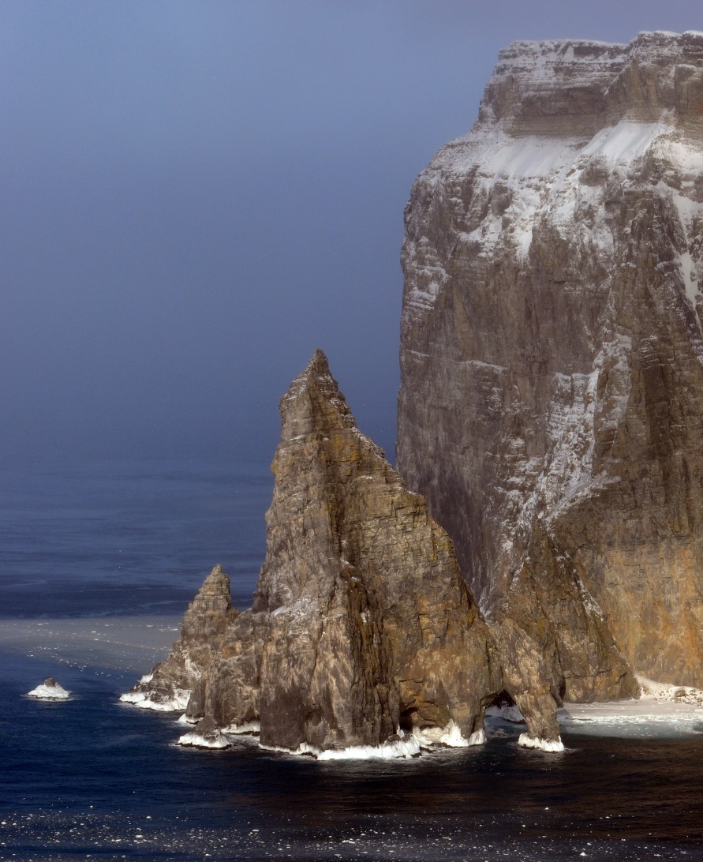
Challenges for oil spill contingency
Cold climate in the northern Barents Sea
Southern Barents Sea less cold
Darkness in winter
Long distances
Complex coastline in areas
Tidal differences
Strong currents

Slide 4
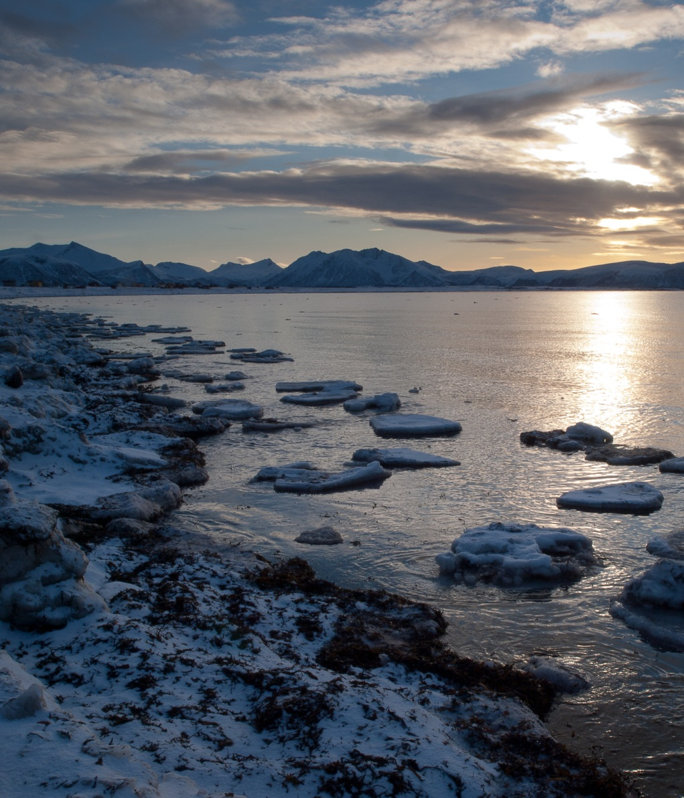
Approaches
Development and experience
Methods and technology
Reflect environmental risk
Also handle worst case scenarios
Risk-based planning while keeping worst case in mind
Higher detail

Slide 5
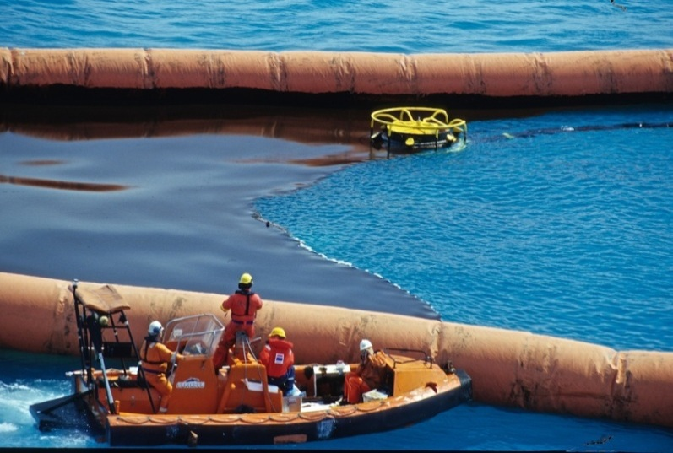
Experience and development
Not all challenges are unique
Experience from operations in cold climates
Exchange of experience between companies

Slide 6
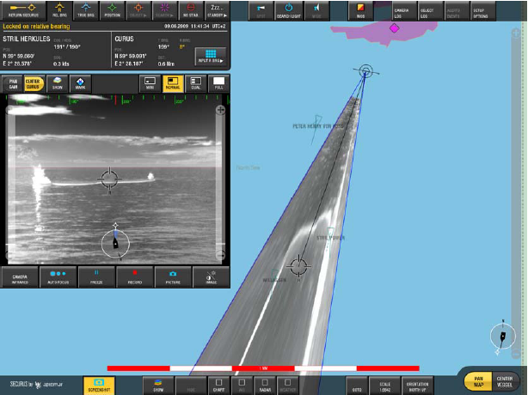
Solutions - technology
Technology development programs offer new technological solutions
Technology
Suited for the environment
Detection and tracking of oil
Improvement
Technology development to meet specific challenges
Several tools in the toolbox
Technological tools to do the job
Strategic tools to use them well
Image: Aptomar

Slide 7
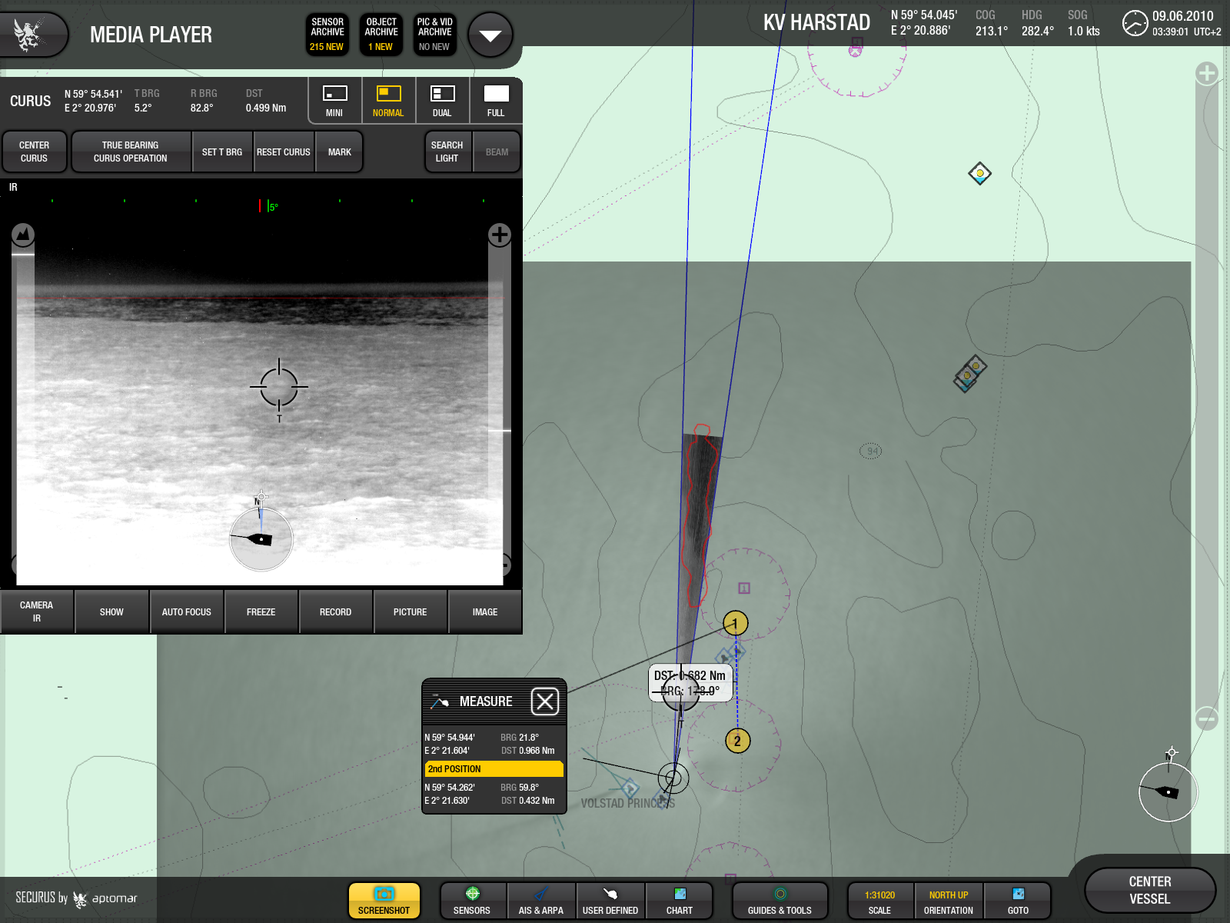
Mapping oil and transfering information
Mapping oil and transfering information
Radars
Image transfer
Image: Aptomar
Image: Aptomar
www. akvaplan.niva.no www.senseweb.no

Slide 8
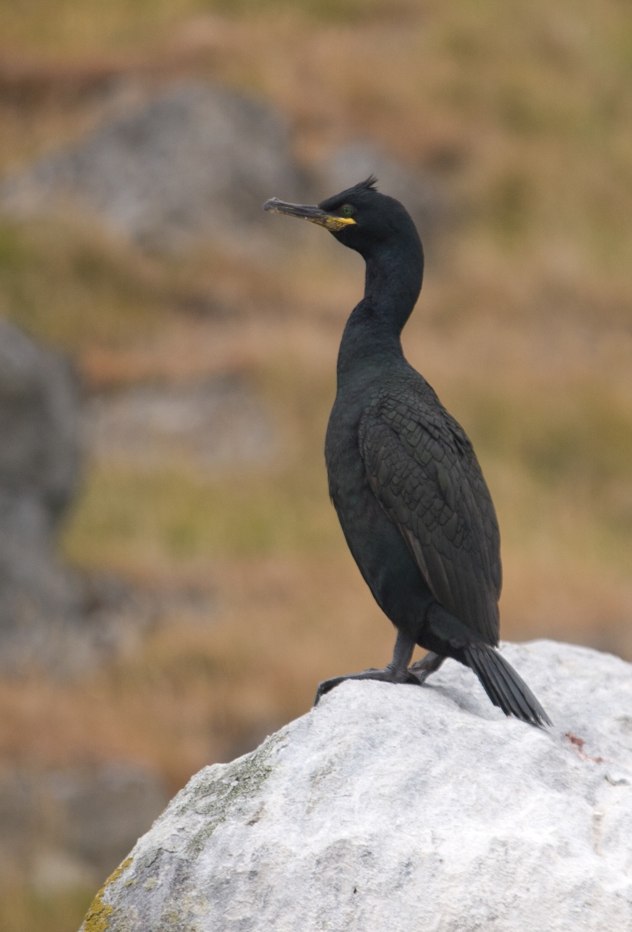
Solutions - strategies
Strategies for areas and natural resources
Planning using scenario thinking
Scaling the operation
Increasing effort
Local adaptation
Detail

Slide 9
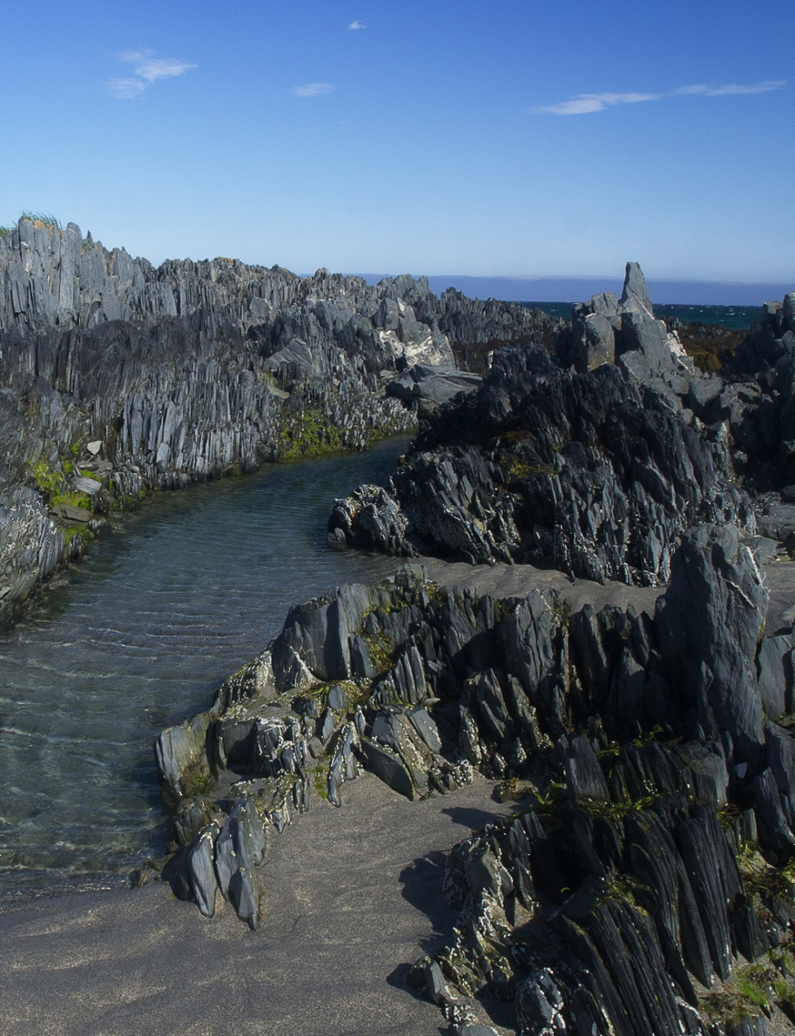
Strategic Environmental Oil Spill Response Planning
Local involvement
Local knowledge
Detailed planning of oil spill combat in sensitive areas
Holistic plan
Developing local ability

Slide 10
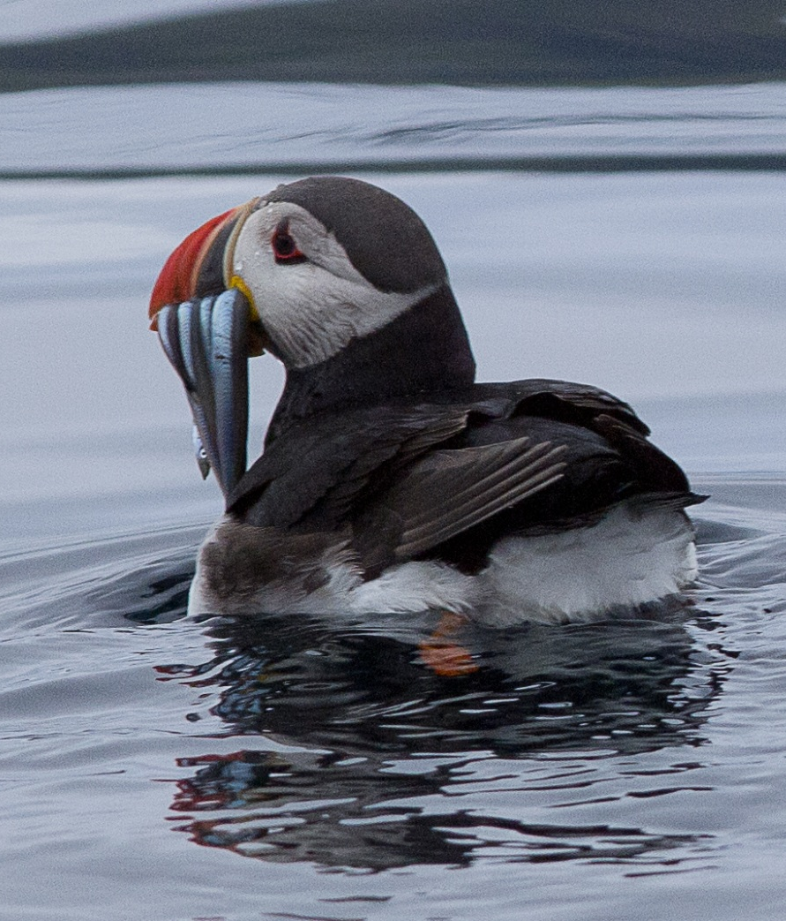
The tool box in sensitive environments
Right equipment for the job
Know where the oil is
Use equipment right
Add real time weather and incident
Flexibility
Tools and equipment
Options
Choose the right strategy for the situation
Make the right decisions in time!

Slide 11
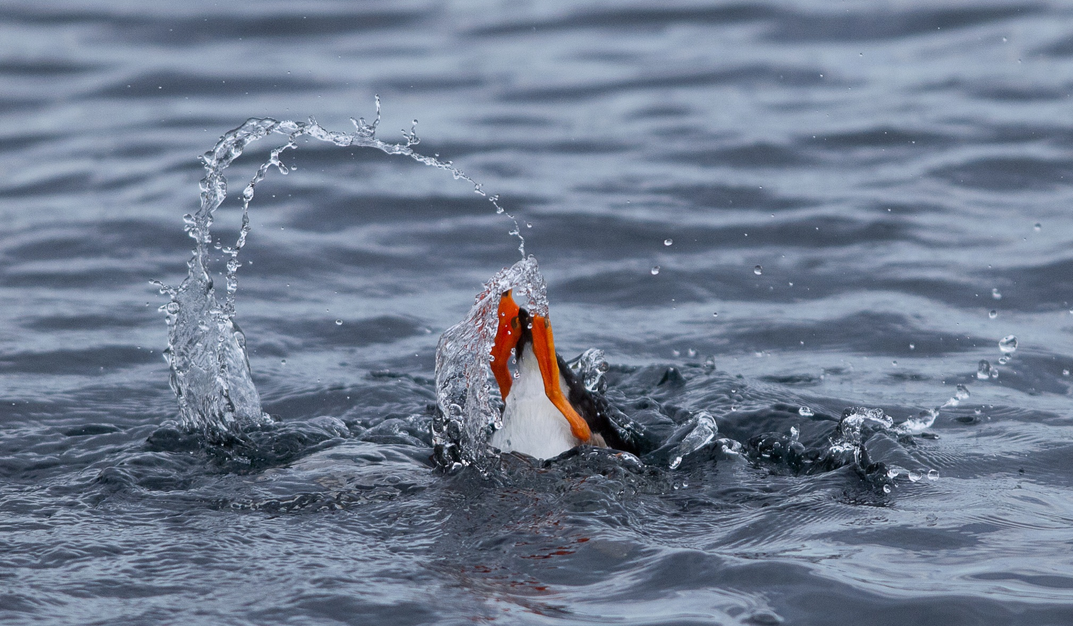
Thank you!
All photography: © Cathrine S. Spikkerud/Geir Morten Skeie, Akvaplan-niva AS

