Slide 1
Security of Supply: Developing Oil and Gas Resources in the European Arctic
Bo Diczfalusy Director of Sustainable Energy Policy and Technology
International Energy Agency
European Parliament
Brussels, 6 March 2012

Slide 2
Policies could radically alter the long-term energy outlook
World primary energy demand by scenario
20 000
Current Policies Scenario
Mtoe
18 000
16 000
New Policies Scenario
14 000
450 Scenario
12 000
10 000
8 000
6 000
1980
1990
2000
2010
2020
2030
2035
In the New Policies Scenario, demand increases by 40% between 2009 & 2035
Source: World Energy Outlook 2011

Slide 3
The age of fossil fuels is far from over, but their dominance declines
Shares of energy sources in world primary energy demand in the New Policies Scenario
50%
Oil
Coal
40%
Gas
Biomass
30%
Nuclear
Other renewables
20%
Hydro
10%
0%
1980
1990
2000
2010
2020
2030
2035
Oil remains the leading fuel though natural gas demand rises the most in absolute terms
Source: World Energy Outlook 2011

Slide 4
Most new oil production capacity is needed to offset decline
World liquids supply by type in the New Policies Scenario
110
mb/d
100
Biofuels
90
Processing gains
80
Unconventional oil
70
Natural gas liquids
60
50
Crude oil:
40
Yet to be found
30
Yet to be developed
20
Currently producing
10
0
1990
2000
2010
2020
2030
2035
Decline at existing conventional fields amounts to 47 mb/d, twice current OPEC Middle East production; NGLs and unconventional production are the main sources of growth
Source: World Energy Outlook 2011

Slide 5
Natural gas & renewables become increasingly important
World primary energy demand by fuel in the New Policies Scenario
5 000
Additional to 2035
Mtoe
4 000
2009
3 000
2 000
1 000
0
Oil
Coal
Gas
Renewables
Nuclear
Renewables & natural gas collectively meet almost two-thirds of incremental energy demand in 2010-2035
Source: World Energy Outlook 2011

Slide 6
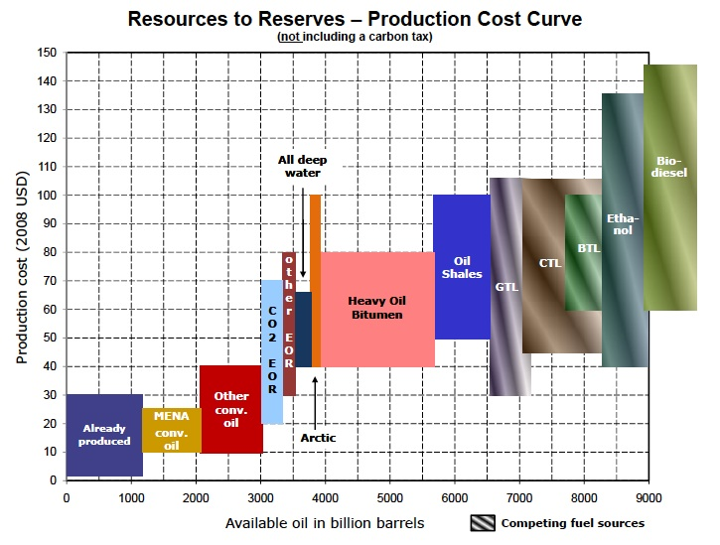
Is there enough oil?
No carbon tax

Slide 7
Improved recovery could boost oil supply
Cumulative oil,
trillion barrels

Slide 8
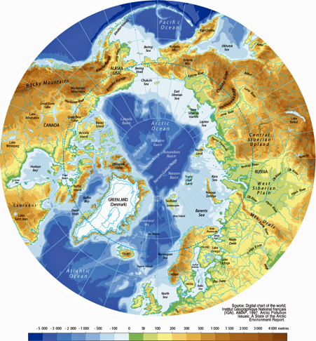
Meeting the Arctic challenges
Arctic resources (USGS):
30% of yet-to-find natural gas
13% of yet-to-find oil

Slide 9
Technology advances in hydrocarbon
exploration and production
Improved and enhanced oil recovery
Deepwater exploration and production
Meeting the Arctic challenges
Protecting pristine environments
Improvements in seismic imaging
Non-conventional oil and natural gas
LNG transportation

Slide 10
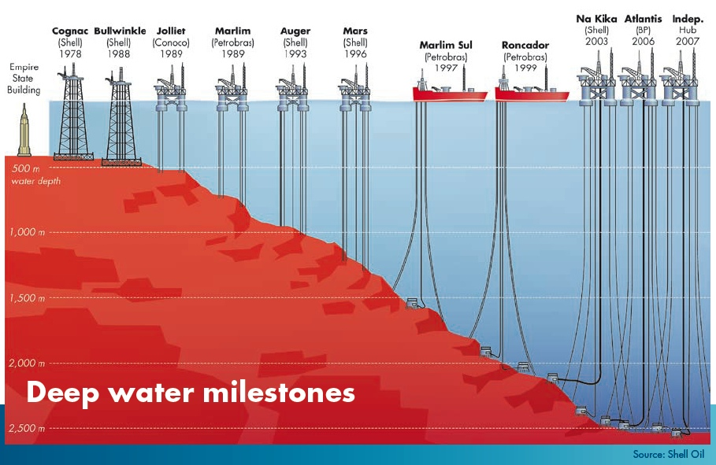
Deepwater exploration and production

Slide 11
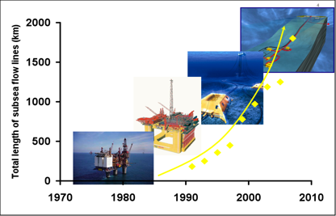
Growth in subsea flowlines

Slide 12
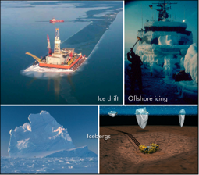
Technical challenges of ice-prone regions
Main challenges:
Avoid ice - Manage ice

Slide 13
Protecting pristine Arctic environments

Slide 14
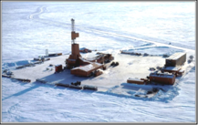
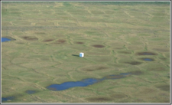
Alpine (exploration site) in winter and summer
Near-zero discharge facility - designed to minimise the environmental footprint

Slide 15
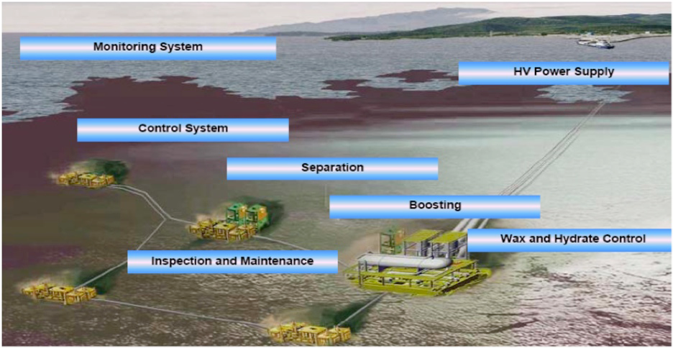
Tomorrow’s zero footprint oil and gas field developments

Slide 16
Conclusions
The projected demand for gas is higher in 2035 than in 2009 for all scenarios. For oil, it falls a little (-8%) in the 450 Scenario
The share of gas in 2035, compared with that in 2009, increases by 1-2% and remains fairly consistent across all scenarios.
Oil and gas resources exist, but they need to be converted into recoverable reserves
Advances in technology are essential
Accessing Arctic reserves presents technological and environmental challenges.

Slide 17
Thank You bo.diczfalusy@iea.org

