Slide 1
3rd Polar Shipping Summit
London May 30th and 31st.
Reece Pitts, Account Manager EMEA & Russia

Slide 2



Iridium Business Update
2
Proprietary and Confidential
Notes:
Ted to cover in more detail
2

Slide 3

Iridium Communications Overview
Vital to the global communications infrastructure
A diverse, global communications provider of mobile voice and data services via 66 in-orbit satellites
We extend the reach of traditional networks to meet the increasing connectivity demand
Serving 508,000 customers
Land-based handset, maritime, aviation, M2M and government
Anchor U.S. DoD customer represents 23% of revenue¹
LTM revenue of $377 million and OEBITDA of $188 million²
2005-2010 service revenue and OEBITDA CAGRs of 18% and 26%³
¹ For the LTM period ended 9/30/11. Includes direct and indirect DoD revenue and revenue from certain other governmental entities through the DoD gateway.
²⁻³ For the LTM period ended 9/30/11.
3

Slide 4

Iridium’s Long-Term Competitive Advantage
Our satellite network provides a superior and differentiated experience for our customers
Unique LEO constellation sets us apart from MEO and GEO systems
Shorter distance to satellites results in a better customer experience
Cross-linked and overlapping “mesh” architecture
Delivers superior availability, efficiency, flexibility and reliability
Near-polar orbit constellation truly means “Iridium Everywhere™”
A healthy constellation
Supports ongoing growth and takes us to the Iridium NEXT era
Notes:
-The orbits that satellites fly in tend categorized in three rough categories – LEO, MEO, and GEO, standing for low and medium and geosynchronous Earth orbits. GEO orbits are the most utilized for communications satellites, since their orbit period is the same as the time it takes the Earth to routine, therefore the satellite appear fixed in the sky
-Iridium provides a LEO constellation architecture with 66 operational satellites in 11 orbital planes, featuring a “mesh” around the globe
-This provides a number of important features
Higher signal quality communications links
Superior, smaller, less power hungry user equipment designs
Lowest possible end-to-end latency (no frustrating “walkie-talkie” conversations)
User and gateway don’t need to be in same satellite footprint
Multiple pathways available to route network traffic from point A to point B
Can mitigate network problems using coverage from neighboring satellites
Make-before-break handover process ensures call continuity as satellites fly in and out of user’s view
No competing system covers the entire planet
Iridium’s “canopy over the earth” uniquely delivers the ability to move information from anywhere to anywhere in near real time

Slide 5
Network and Constellation Performance Outlook is Good
Iridium seeks to ensure the highest possible quality experience for users and partners
The network is continuously monitored and measured
Currently have 66 operational satellites and 6 on-orbit spares routinely providing greater than 98% call establishment rate
Longevity outlook is favorable due to unique operational factors:
  Lower than anticipated subscriber load and smart power management have preserved battery life
  Systems robustness and design permits graceful degradation
  Satellite processing architecture allows continuous modifications to flight software
  Orbital altitude regime (780km) experiences 1/10th the radiation experienced by some other LEO constellations
On-orbit spares provide capability to quickly replace failed satellites:
  Teleport Network architecture provides fast response grounding of communications traffic in response to anomalies
  Supports capacity expansion
Our network is planned to provide a commercially acceptable level of service through the transition to Iridium NEXT

Slide 6

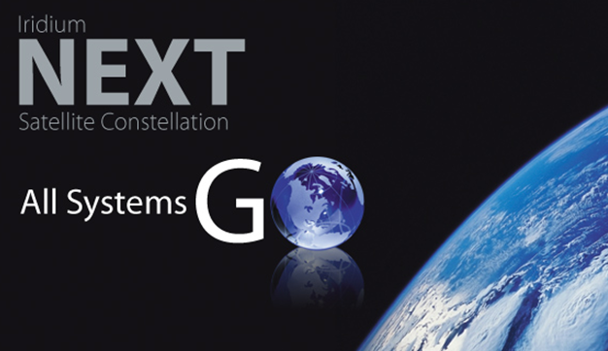




Iridium NEXT Positions Us for the Future
Fully funded approximately $3 billion plan that supports our
success for many years¹
Compatibility with existing network and devices
Smooth network transition and customer continuity
Retains LEO architecture with 66 new operational satellites
6 in-orbit spares and 9 ground spares
Scheduled deployment between early 2015 and 2017
Via 8 Falcon 9 launches (9 SVs/launch)
Expanded capacity and higher data speed capabilities
¹ Note – Fully funded approximately $3 billion business plan assumes borrowings under the $1.8 billion Coface financing agreement, together with internally generated cash flow, including cash flows from hosted payloads.
6

Slide 7

Favorable Competitive Dynamics & Positioning
Market
Growth⁽¹⁾
Key Competitors
Iridium
Advantage
Growth Strategy
Position
#1 position Premium provider | 2-3% CAGR thru 2015 | Globalstar Thuraya (regional) Inmarsat | True mobility Coverage Reliability | Multi-device portfolio Profitable hardware cost structure
Fastest growing; best prospects Premium provider | 18% CAGR thru 2015 | Orbcomm Inmarsat Globalstar | Coverage Low latency Throughput | Hardware cost reduction IP licensing
#2 position Fastest growing Value provider | 11% CAGR thru 2015 | Inmarsat | Coverage Low cost Small antenna | #1 in 134 kbps Cost-effective Expand value markets
#1 in general aviation Value provider | 13% CAGR thru 2015 | Inmarsat | Coverage Low cost Small device | Iridium OpenPort-AeroSM Safety services
#1 low-speed data and voice | 6-8% CAGR thru 2015 | Inmarsat | True mobility Coverage Netted Security | Netted M2M solutions Proprietary secure voice
Land
M2M
Maritime
Aviation
Government
Northern Sky Research (2010) for MSS L-Band market
7

Slide 8
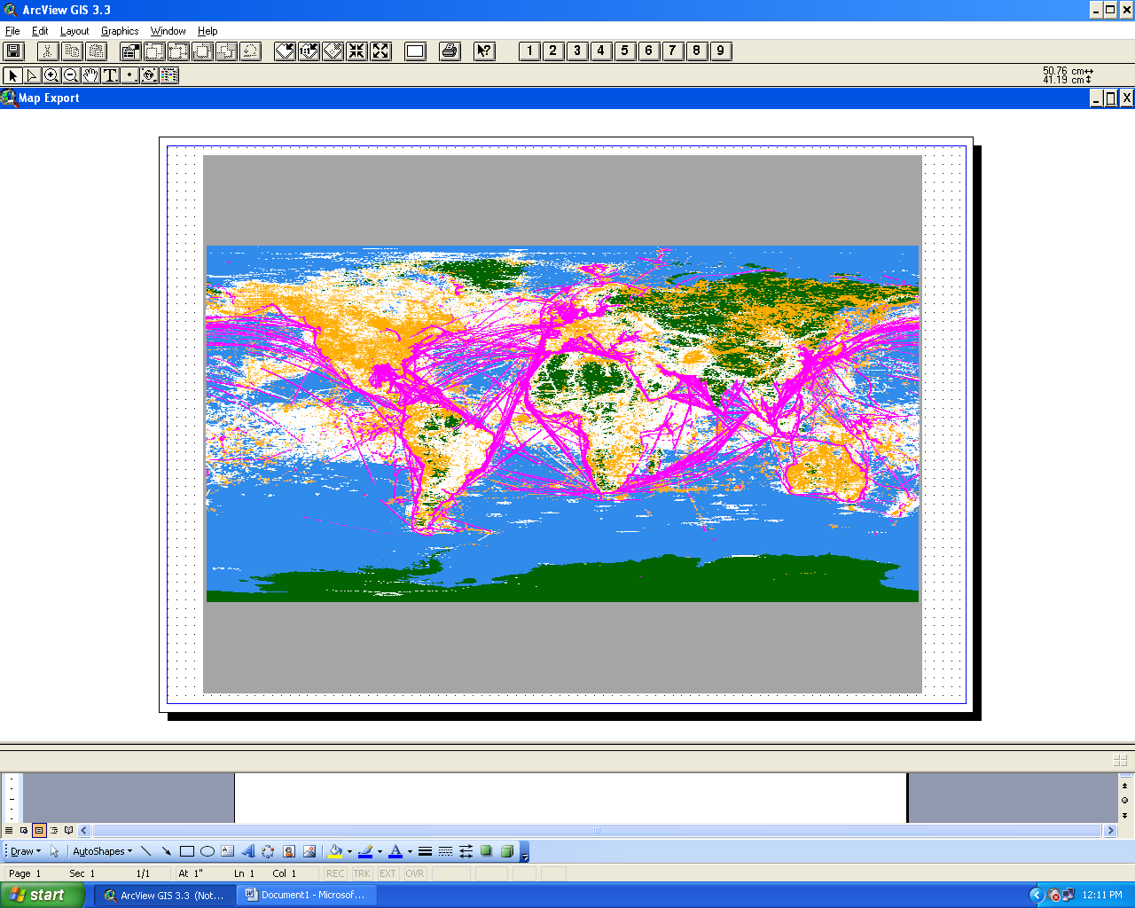
Network Leadership Fuels Global Usage
Diverse network traffic with significant growth opportunities
M2M (SBD) Data Transmission
Voice Call
High-Speed Data Traffic
Note: One week plot of M2M/SBD session, voice call and high-speed data origination points for the week of 7/10/11 to 7/16/11 (commercial traffic only)
8

Slide 9


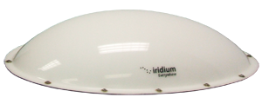
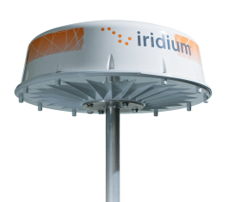

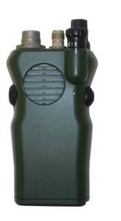
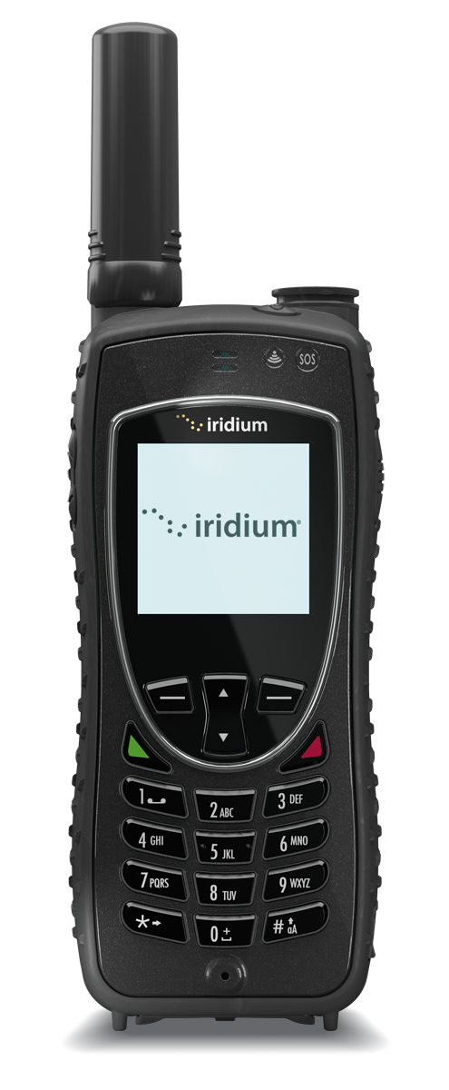
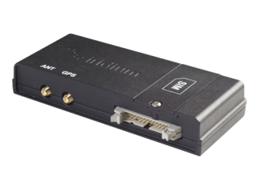
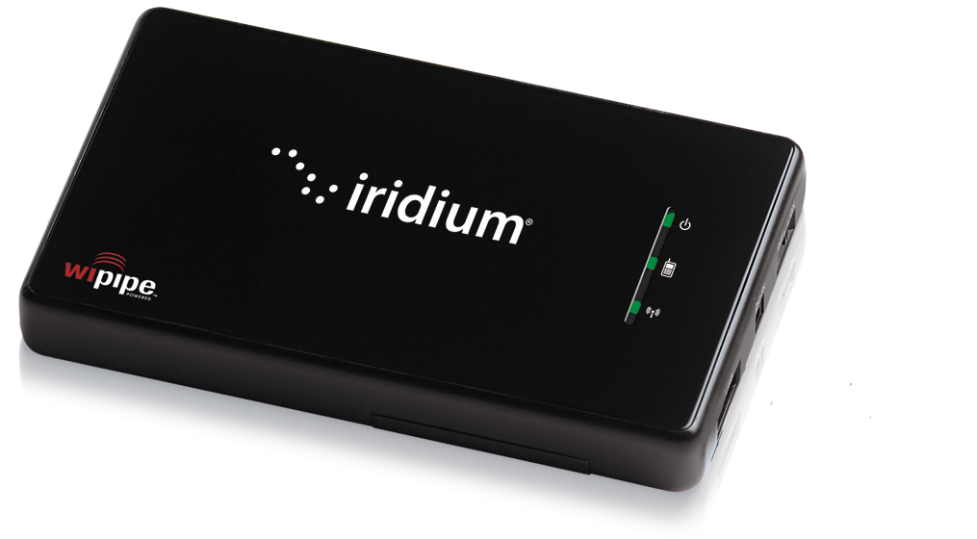
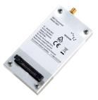
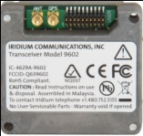
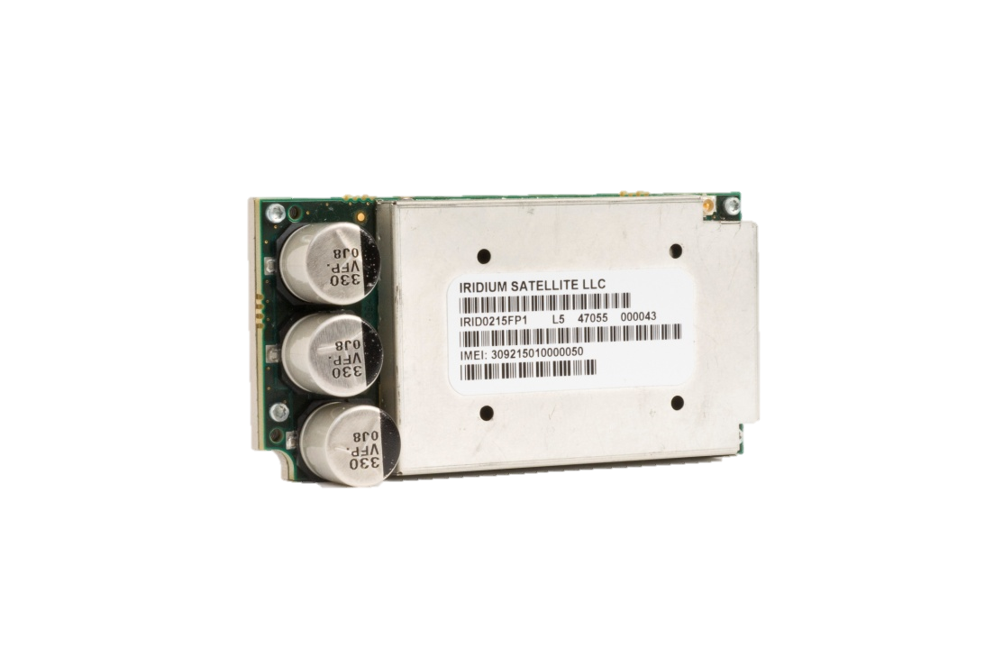
Accelerating Growth Through Relentless Innovation
43% of cumulative service revenue growth from new products during the last three years
Iridium
OpenPort-Aero
Pre-Iridium NEXT
Devices
Iridium OpenPort®
Iridium Extreme™
Iridium
9505A
U.S. DOD
Tactical Radio
(Netted)
Original
Motorola
Voice
Handset
Iridium
9555
Voice
& Data Modem
Iridium AxcessPoint
Iridium 9522B
M2M
9601
M2M
9602
iGPS
Iridium Core 9523
M2M
Chipset
2001
2012
0 Partners
> 275 Partners
9
Notes:
Once we were able to expand the type of devices that we offered – we moved from a simple voice product, to a circuit switched data modem, to a voice and data modem that could be built into ships and airplanes, to a small packet based device that could create an Internet connection anywhere, we were able to address the real needs of many enterprises who were frustrated with the reach of terrestrial cell phone technology.
Our latest technology, developed largely by the team here at CCL, takes us into the high speed data business – a fast growing market as the need for bandwidth around the globe is exploding.

Slide 10

Tenets of Our Product and Technology Strategy
JOEL
        Simplifying connections,
        everywhere
        Smaller,
        lighter, less expensive
        3. New services
        as a catalyst
        Iridium NEXT enabled
        products
Notes:
relive the experiences of your first partners conference.
Aloha – it’s a privilege to be presenting to you
share with you a view of the strategic direction
redefining the somewhat narrow MSS market of Maritime, Aviation and Land. We are developing the tools to allow you to go beyond the traditional MSS market.
We have 4 key tenets of this strategy:
Simplify Connections means two things
Iridium Force strategy of connecting personal portable WiFi devices
technology options to connect to Iridium; Modules, components and waveforms
Size, Weight and Cost
- reduction of size, weight and cost is a necessity for us all to dramatically increase sales and penetration into markets not previously served
As you know our goal is not to build everything ourself…so we need to give you smaller, less expensive options
New Services
Historical investments in new services: OpenPort, Aviation Safety Services
Commercial PTT and Global Data Broadcast.
Preparing You for NEXT
Herman and I are currently thinking about how we can help you prepare for NEXT.
Our goal smoothest transition possible to NEXT and a path to grow your businesses with Iridium
We will share with you:
a new set of ASICs that are NEXT upgradable
timing to receive technical documentation

Slide 11
Iridium Extreme
11
Proprietary and Confidential
Notes:
Ted to cover in more detail
11

Slide 12

Iridium Force ™ is our vision for using the power of the world’s furthest reaching network to bring extended & enhanced personal communications to people and organizations, everywhere
Tenets of Iridium Force -
  Extend beyond satellite phones
  Simplify connections
  Drive innovation
  Enable location-awareness
  Perform without compromise
  Iridium Force encompasses –
  Iridium Extreme™
  Iridium Core 9523
  LBS Data Offerings
  Iridium AxcessPoint
2015
Notes:
Marketing Launch Program:
Development of a complete communications program targeted to our partners, key stakeholders and end-users
The new Iridium handset is part of a larger corporate brand strategy – Iridium FORCE and will include ongoing in-hand communications products, such as a wireless device, and personal locators devices developed by our partner ecosystem.
Incl: Iridium Extreme, Iridium Wi-Fi Accessory, Wi-fi Software, etc
Handset has been launched with the brand name – Iridium Extreme, with “9575” becoming the model number.

Slide 13

2015
Notes:
Marketing Launch Program:
Development of a complete communications program targeted to our partners, key stakeholders and end-users
The new Iridium handset is part of a larger corporate brand strategy – Iridium FORCE and will include ongoing in-hand communications products, such as a wireless device, and personal locators devices developed by our partner ecosystem.
Incl: Iridium Extreme, Iridium Wi-Fi Accessory, Wi-fi Software, etc
Handset has been launched with the brand name – Iridium Extreme, with “9575” becoming the model number.

Slide 14
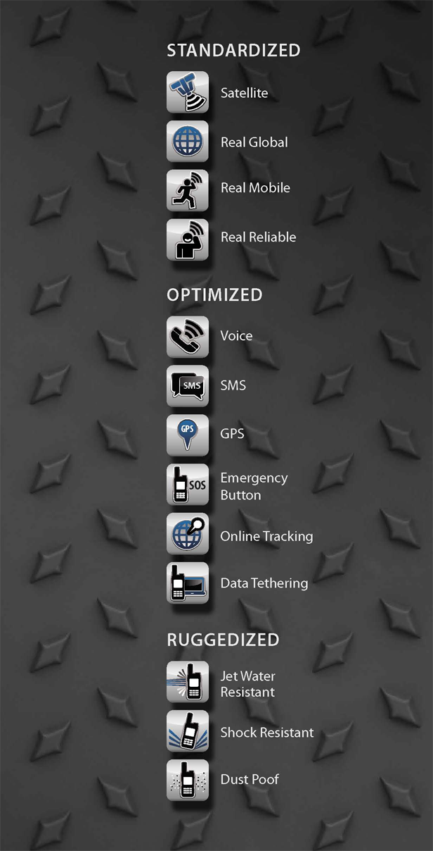
Iridium
Extreme
The ultimate in ruggedized, optimized and standardized engineering – the one handset that does it all, enabling users to make more of the connections that matter, under the harshest conditions from the furthest reaches of the planet.
Notes:
This is at heart the product storyboard. All that sets this satellite phone apart in the industry is here.

Slide 15
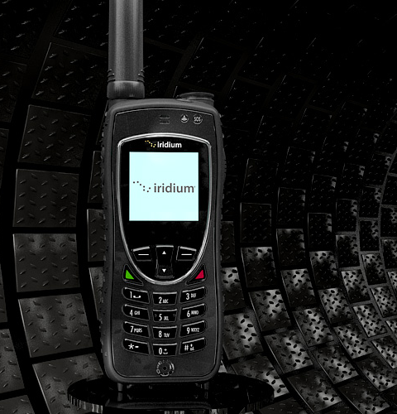

Smarter
Iridium Extreme is the first GPS-enabled satellite phone ever to offer an open development platform for LBS and dedicated S.E.N.D. compliant SOS button.
It is engineered with more features and unique accessories than any other satellite phone on the market, giving people more ways to connect than
ever before.
Iridium Proprietary and Confidential

Slide 16

Tougher
It may be our smallest satellite phone, but Iridium Extreme
is the toughest ever built. It is ruggedly engineered to support the toughest, highest usage customers of satellite phone communications in the harshest conditions, everywhere.
No other phone in the world
has more guts or grit than
Iridium Extreme.
Iridium Proprietary and Confidential

Slide 17
Introducing the newest handheld product from Iridium, on the farthest reaching, global satellite network….
The Iridium Extreme Satellite Phone
With a series of industry firsts…
The First Military-Grade Satellite Phone
The First IP65 Rated Satellite Phone
The First Open Development Platform for Location Based Services
The First Satellite Phone with a Dedicated,
Satellite Emergency Notification Device (SEND)
Compliant SOS Button

Slide 18
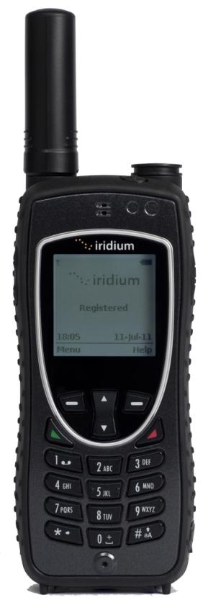

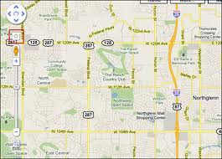
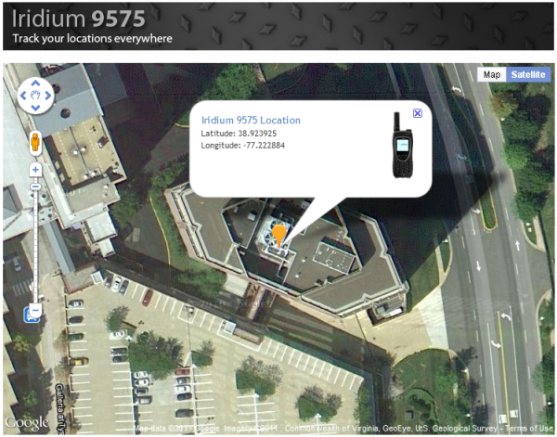
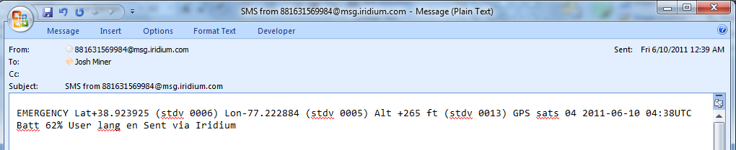
Feature-Rich
GPS-enabled location-based services with programmable location service menus
SOS functionality build-in and thru Partner Portals such as The Stratos Advantage™
Online tracking / Geo-fencing thru StratosTrax™
Managing Social Property
Iridium Proprietary and Confidential

Slide 19
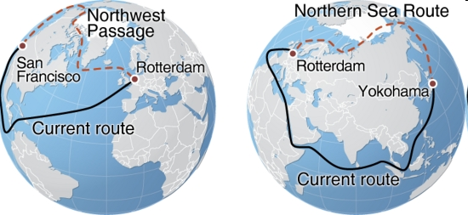
Contributing to Maritime Security & Safety Services
International Ship & Port Security code (ISPS) – Ship Security Alert System (SSAS)
Long Range Identification & Tracking (LRIT)
  cost-effective, robust LRIT solutions to meet IMO carriage requirements
  Iridium is the only MSS Provider covering Sea Area A4
Modernization of GMDSS & e-Navigation
  non GMDSS safety services
  need for expanded safety with opening of Arctic Sea Routes
  Iridium is the only MSS Provider covering GMDSS Region A4 / served only by HF radio
Anti-Piracy :
  IMO Best Management Practices
  UK Maritime Trade Operations (UKMTO)
  Shipboard Citadel
      NATO– citadel advice on communications
        http://www.shipping.nato.int/CounterPir
19
Iridium Proprietary and Confidential

Slide 20
Iridium 9603 Product
20
Proprietary and Confidential
Notes:
Ted to cover in more detail
20

Slide 21
Executive Summary
Iridium is dedicated to expanding our reach – both in size and scope.
The next step along that innovation path is the Iridium 9603 transceiver – the world’s smallest, commercially available, two-way satellite transceiver.
Five partner Value-Added Manufacturers have stepped up and are serving as Beta integrators. Their products will be ready for launch shortly after Iridium’s 9603 commercial availability launch on June 4th.
The product was announced at CTIA on May 8, 2012 with product launch following.
The Iridium 9603 will serve as a new device in the Short Burst Data service family of devices and will not replace the Iridium 9602.

Slide 22

A Revolution in Scale
The compact Iridium 9603 is the world’s smallest commercially available two-way satellite data transceiver — designed for applications where space is at a premium and connectivity is critical.

Slide 23
Iridium 9603 Overview
A data transceiver that’s designed to be integrated into a partner’s wireless data application, no matter how small!
Iridium’s latest data module is downsized from a matchbox (the Iridium 9602) to smaller than a matchbook – supporting partners’ solutions with product size constraints and limitations.
Expands Iridium’s reach into new market opportunities in the consumer and enterprise spaces.
Introduces a new level of innovation for Iridium’s data product line
    Maintains the same functionality as the Iridium 9602: fully capable Short Burst Data, PCB level integration, screw mounting, etc.
    Size and volume reductions (from the Iridium 9602) are possible because of a migration to the latest-available component package sizes and design techniques, elimination of unneeded functionality and the use of a new RF power amplifier (Mimix XP 1077)
Establishes a second source for Iridium RF design – providing a new source of innovation.
Notes:
Become provider of the smallest data module footprint in MSS space

Slide 24
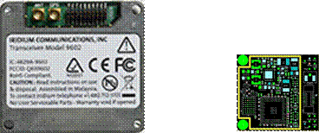
Unprecedented Form Factor
Designed to go where no commercial satellite transceiver has gone before
With the smallest form factor of any commercial satellite transceiver available today, the Iridium 9603 is ideal for space-constrained applications including handheld tracking, covert operations, infrastructure monitoring, and alarm systems.
One-fourth the volume and half the footprint of its predecessor, the Iridium 9602, the Iridium 9603 combines the global coverage of the Iridium satellite constellation with the low latency of the two-way Iridium Short Burst Data service to provide highly reliable satellite communications from pole to pole.
Iridium 9602
Iridium 9603

Slide 25
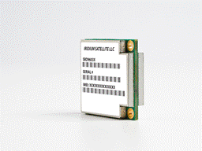

Why push boundaries when you can erase them instead?
Redefining the spatial possibilities of satellite communications devices, the Iridium 9603 provides significant data capabilities within a good value proposition.
Helping expand the Iridium ConnectedTM user base worldwide, it supports:
Mobile-originated messages (up to 340 bytes)
Mobile-terminated messages (up to 270 bytes)
Low, uniform global latency (less than 1 minute)

Slide 26
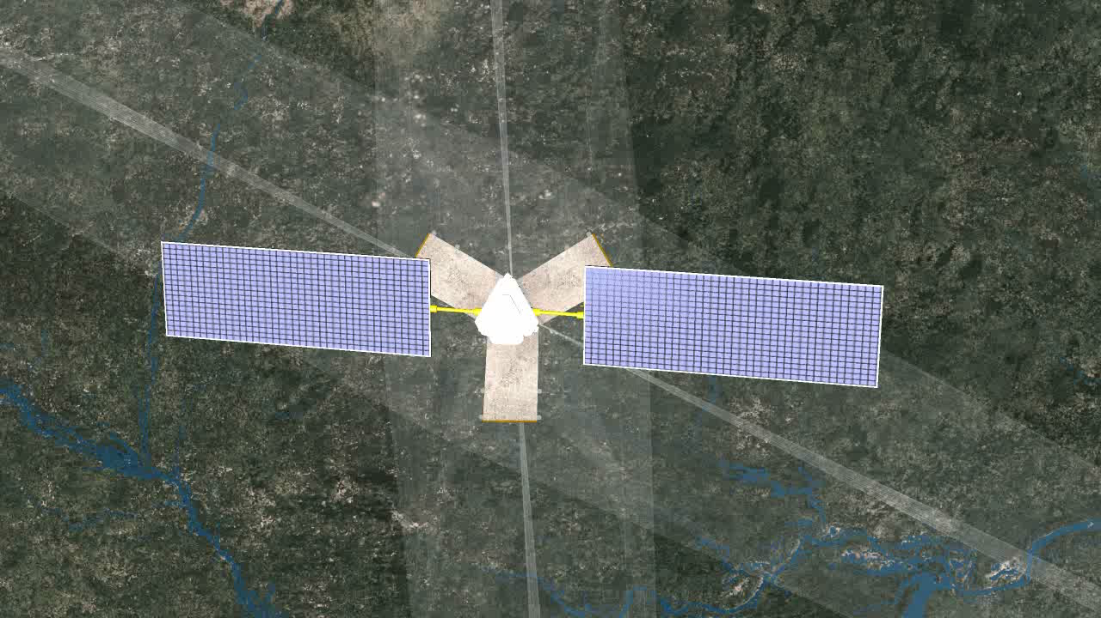

Slide 27

: Greenland MSI – Sept 09 onwards
Arctic NAV AREAS introduction in 2011
  Additional transmitters required in time for that introduction or find an alternative
DaMSA invited Iridium to propose an alternative to NAVTEX
Building a pilot demonstration of MSI delivered over Iridium (NAVTEX equivalent) to arctic regions
Demonstration will run from September
Danish Naval vessel(s)
Completely configurable - highlights
  Interfaced to printer / will print message once
  Messages cancellable & transmitted as warning requires
  Pilot to mimic NAVTEX but there are additional features on Iridium which mean it can be executed differently with same impact
  Geo-location capability for vessels entering / leaving NAV AREA

Slide 28
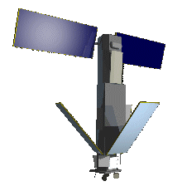
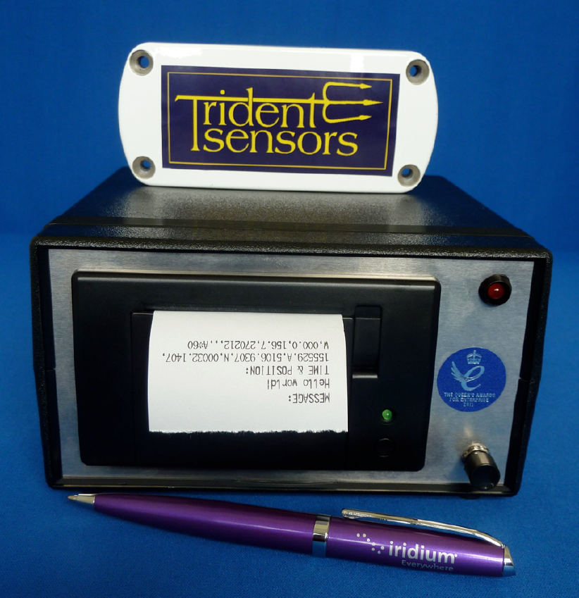
: Greenland MSI
Message tx + ack
Message retransmit, or
Geo-fence entry sensed, tx
Ship
Iridium MSI
Input Interface
Greenland Command
MSI Origination
Ship 2
RB
WARNING NO. 168
GALE WARNING FOR:
KANGIKAJIK:
NORTHNORTHEAST 15 M/S.
APUTITEEQ:
NORTHEAST 23.
RB
WARNING NO. 168
GALE WARNING FOR:
KANGIKAJIK:
NORTHNORTHEAST 15 M/S.
APUTITEEQ:
NORTHEAST 23.

Slide 29
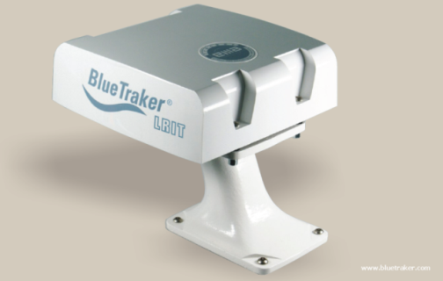

Canadian Coast Guard - LRIT Arctic Trials
3 different LRIT terminals under test
  Inmarsat C, SkyWave D+ & Iridium
  Installed on 3 CGG icebreakers patrolling Canada’s Arctic waters
Tests and performance monitoring of all 3 systems well underway, will continue throughout the 2009 Arctic season
Results will be reported by Canada to the IMO
Iridium VAM Partner: EMA, BlueTraker LRIT terminal
Iridium VAR Partner: Pole Star, Canada’s LRIT ASP

Slide 30


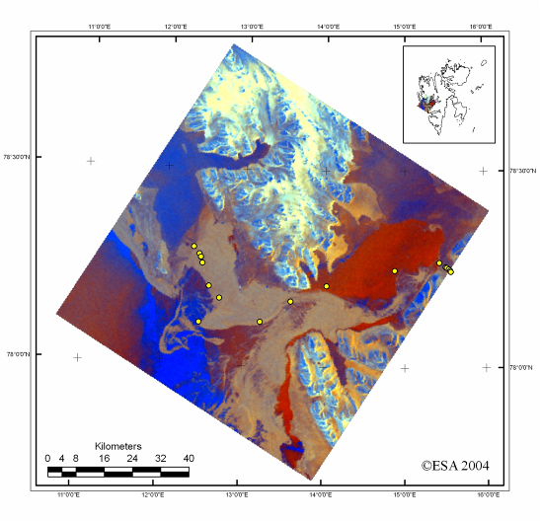
KSAT Ice Navigation
Optimal Routing
Planned direct route
through the ice
6 hours
Actual route
around the ice
3 hours
The view from above
halved the journey time

Slide 31



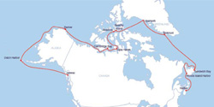
The Open Passage Expedition:
Sailing the Canadian Arctic
S/V Silent Sound (4 crew) 7,000 miles in 4 months from Victoria, BC
to Halifax, NS over the top of Alaska and Canada
Relying on Blue Sky Network’s Iridium-based D2000 GPS Tracking
Device and Iridium 9555 Satellite Phone for real time tracking and
critical voice and data communications
Notes:
Around the Americas

Slide 32


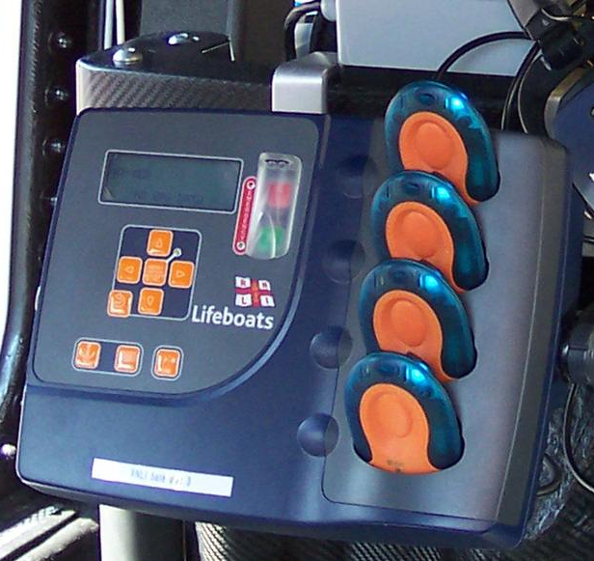
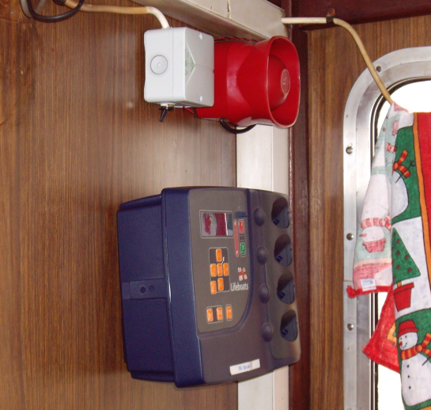

Royal National Lifeboat Institution
Man Overboard Guardian
Vessel overdue – hourly transmissions
Man Overboard
UK fishing fleets
RNLI / AWS / McMurdo / Iridium Satellite
Lives saved

Slide 33

Iridium Everywhere
The Facts Speak for Themselves
Iridium delivers the world without limits, without compromise and without exception.
Iridium covers every inch of the Earth’s surface
Iridium is unmatched for secure, near real-time services and network availability
Iridium manufactures rugged, reliable and easy to integrate devices
Iridium creates Reliable Critical Lifelines with hundreds of mission critical applications
Iridium is advancing the way global enterprises do business
Iridium is growing, profitable and on-track to launch Iridium NEXT

